Slide 1
Rescue the Prisoner
Software development project-II
CSE 3200
Developed by
Md. Masum Billah
1207002
Nabil Sarwar Rahat
1207013
Supervised by
Mr. Animesh Kumar Paul
Lecturer,
Dept. of Computer Science & Engineering
Khulna University of Engineering & Technology

Slide 2
Objectives
Become familiarization with Unity, C sharp language and it’s features.
To develop a software project.
To make a source of entertainment of the people.
To design a software.
To make a source of passing leisure time.

Slide 3
Why “Rescue the Prisoner”?
Our project is a Game. This is based on protecting the prisoner from the enemies. I am the only soldier. My work is to save the prisoner.
At present time , shooting game is popular
and it’s popularity is increasing day by day.
To make a fighting game like this we had to consider both the design part of the scene and also the scripting which will be very much necessary for our future life.

Slide 4
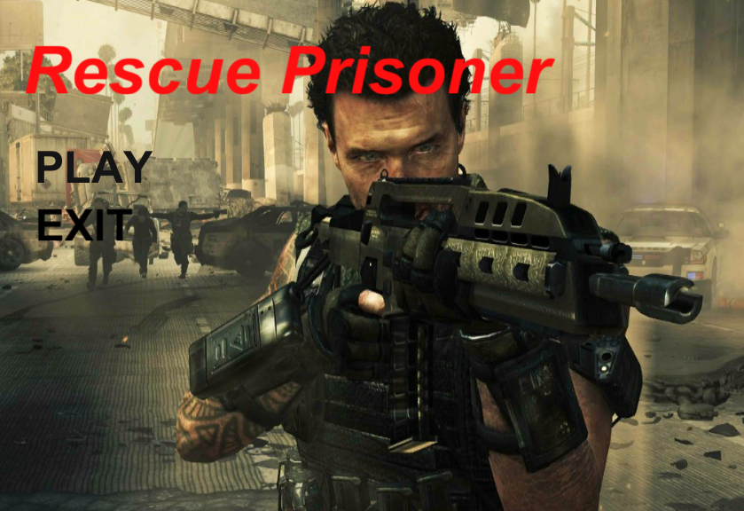
Features of “Rescue the Prisoner” Firstly, there contains a mainframe with two options: PLAY EXIT

Slide 5
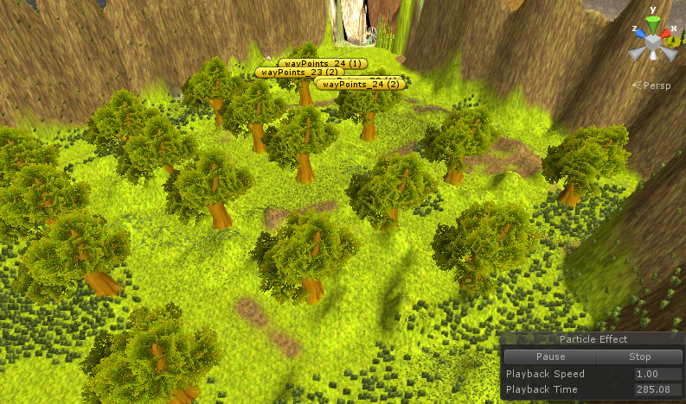
Player Entrance Scene

Slide 6
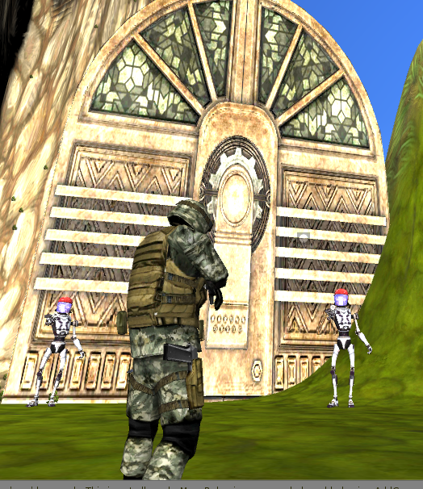
Enemy at Entrance Door

Slide 7
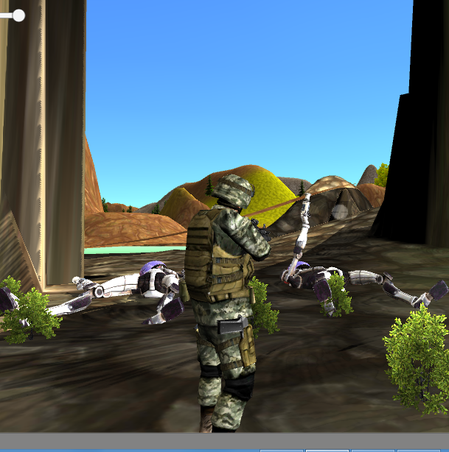
Opening Door After Enemies Death

Slide 8
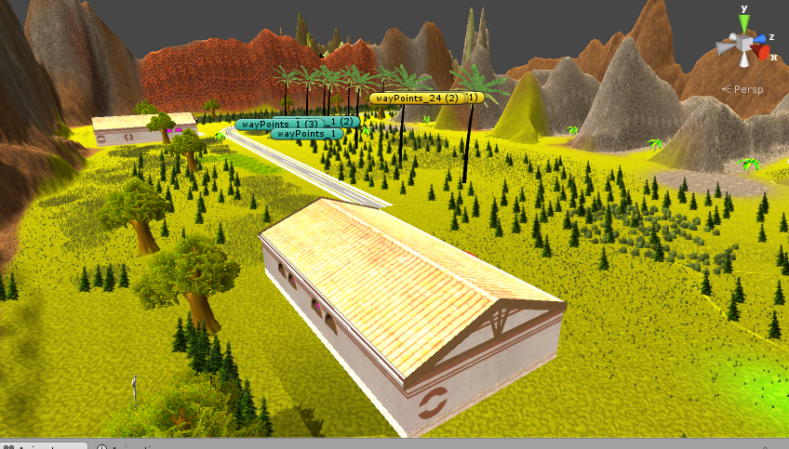
Main Area View

Slide 9
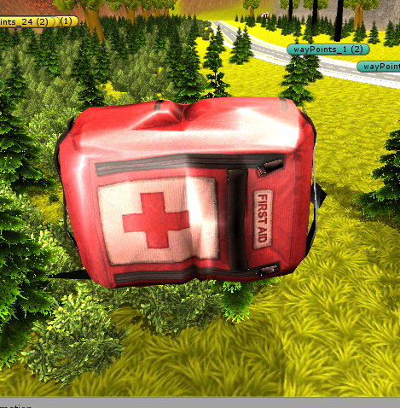
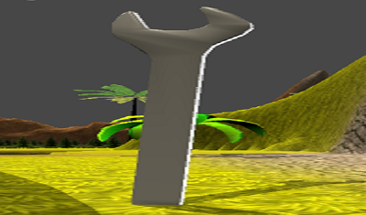
Health Pick-up and Key Point of Player

Slide 10
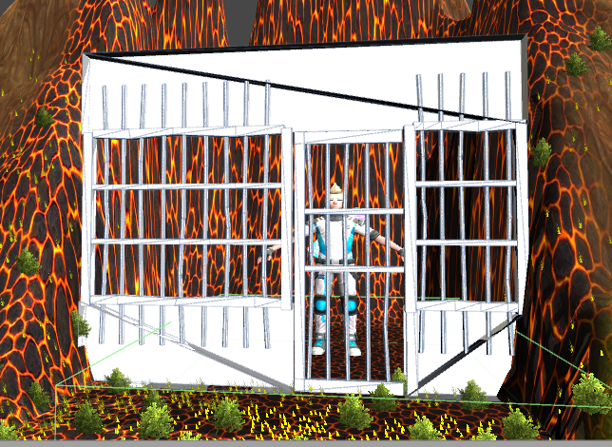
The Prisoner’s Location

Slide 11
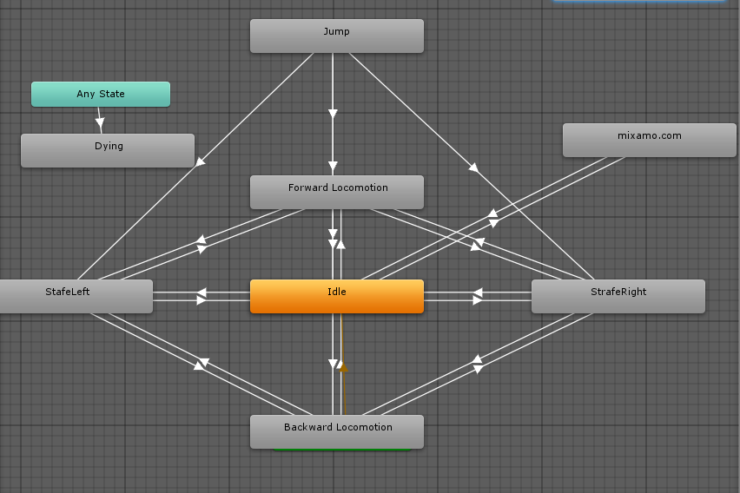
Example of State Diagram Used in the Project

Slide 12
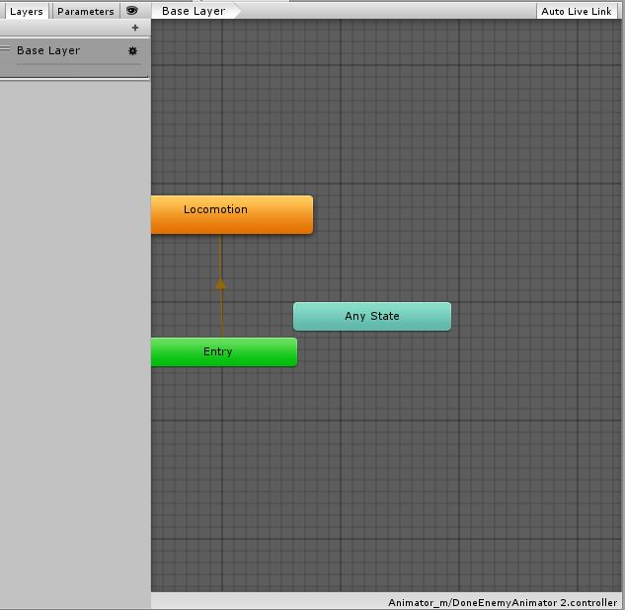
Enemy Animator First Layer

Slide 13
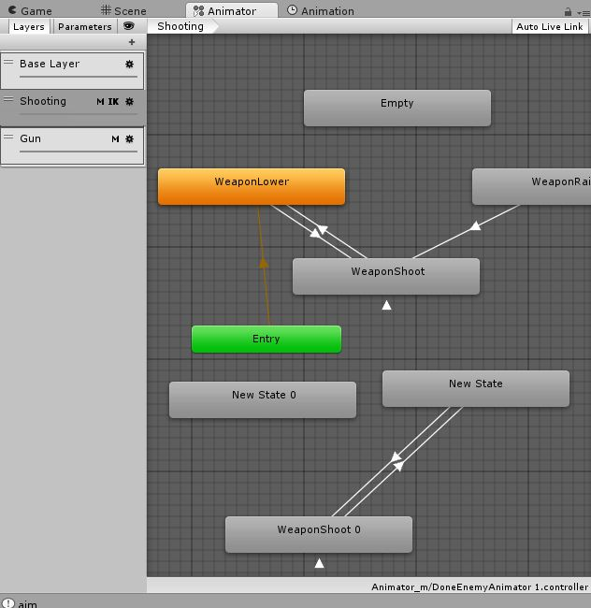
Enemy Animator Second Layer

Slide 14
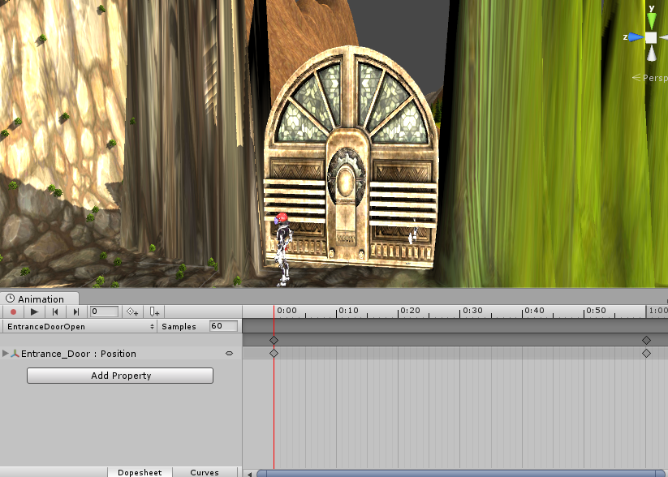
Example of Animation Window

Slide 15
Limitations
Touch input
Advanced artificial intelligence
Advanced character controller which will include various types animation like crawling, rolling etc.
Designing the scene with more realistic effect
Multiple stage scene.

Slide 16
Future Plan of “Rescue Prisoner”
Adding touch input
Adding advanced artificial intelligence
Advanced character controller which will include various types animation like crawling, rolling etc.
Designing the scene with more realistic effect
Multiple stage scene
Inside gaming options will be increased.

Slide 17
Conclusion
We have acquired a satisfactory knowledge on unity.
We have successfully brought a conclusion to our game project “Rescue the Prisoner”.
While doing so many times faced a lot of difficulties .
We overcame these obstacles by taking help from our supervisor as well as our seniors.
The project may be small but it inspires us to do something bigger in future.

Slide 18
Debug.Log( “Thanks to all”);

